Slide 1

Registered student organization training
FALL 2025

Slide 2
AGENDA
Introductions & Staffing Updates
ENGAGE: Goucher Updates
Event Management Process
Finance & Budget
RSO Handbook: Coming Soon!
General Questions

Slide 3
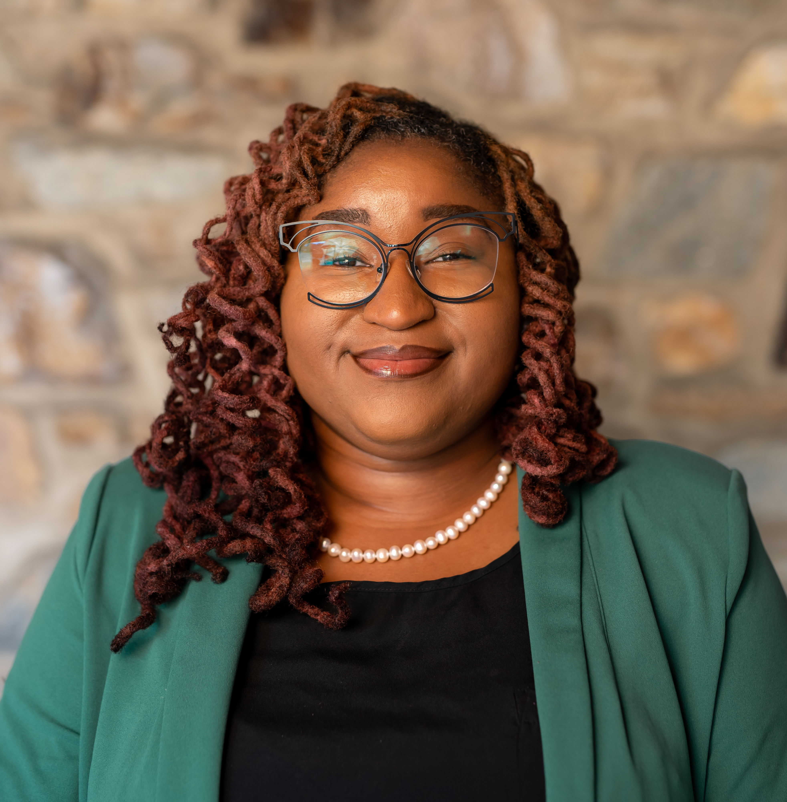
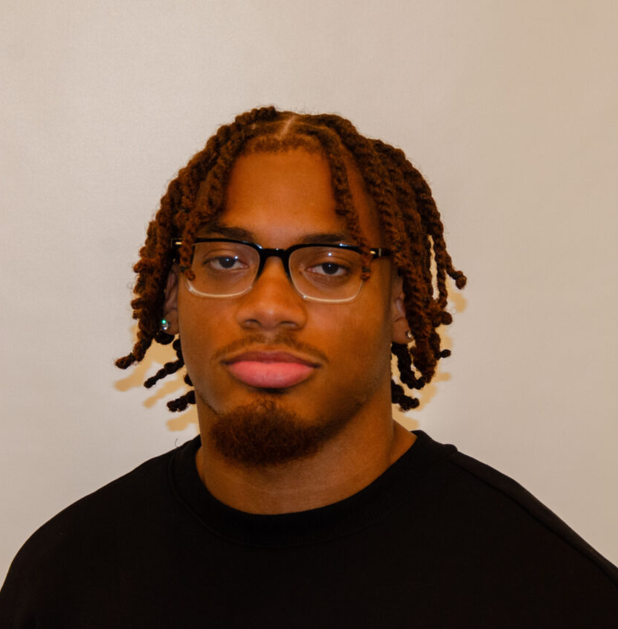
Who we are
Erica Gardner
Vacant
Deonte Lewis
Director of Student Engagement
Office Hours (OSE):
  By appointment Monday – Thursday for event management inquiries
Email: Erica.Gardner@goucher.edu
SGA Director of Student Organizations
Office Hours (OSE):
Email: sgaclubs@goucher.edu
SGA Treasurer
Office hours (OSE): TBD
Email: sgatreasurer@goucher.edu

Slide 4
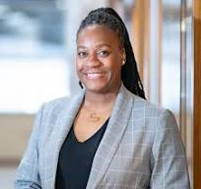
SGA Executive Board & Cabinet
Christian Houck
President
Erica Gardner
Advisor
Stephanie Johnson
Advisor
Laney Dorr
Vice President
Liz Hannaford
Chief of Staff
Deonte Lewis
Treasurer
Elowyn Ingler
Attorney General
Cadita Attipoe
Director of Communications and Marketing
Max Ravnitzky
Director of Academic Affairs
Ezra Burke
Director of Special Events and Procurement
Jermaine Horsey
Director of Student Affairs
Vacant
Director of Registered Student Organizations
Tanise Thornton-Fillyaw
Director of Equity & Inclusion
Notes:
Emma to fill in

Slide 5
Engage: goucher

Slide 6


Slide 7
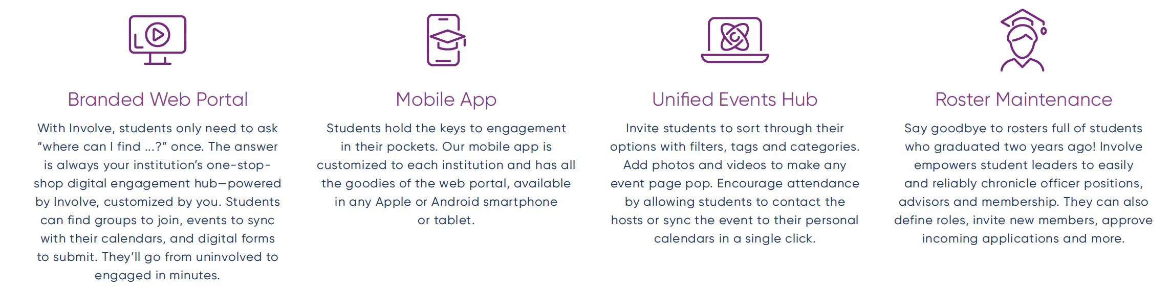
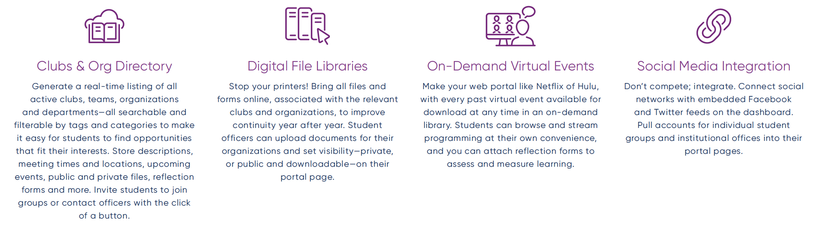

Slide 8
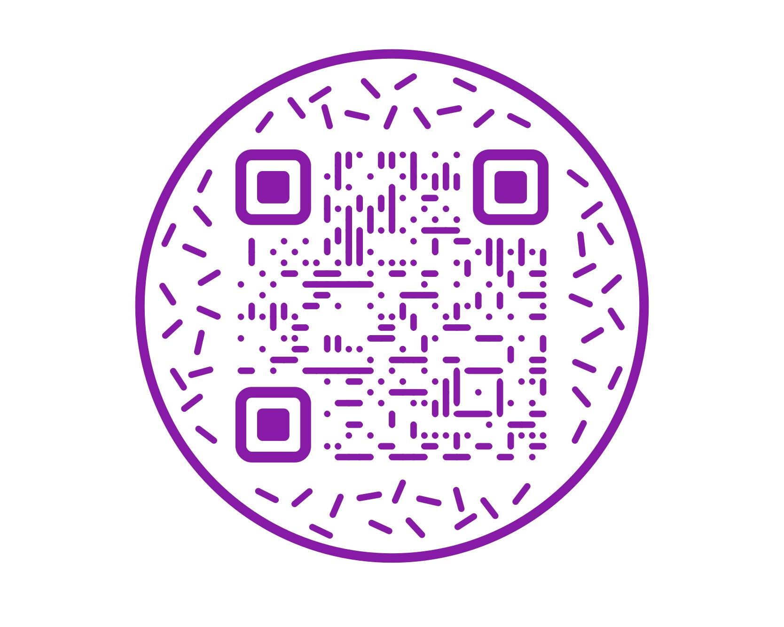
Download the app today!

Slide 9
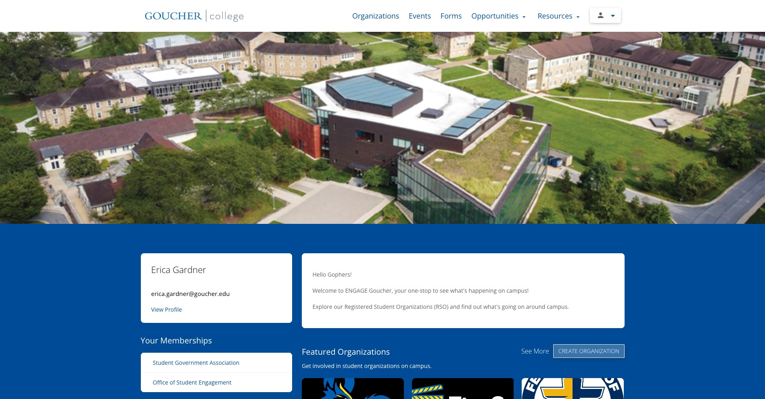
https://goucher.presence.io/

Slide 10
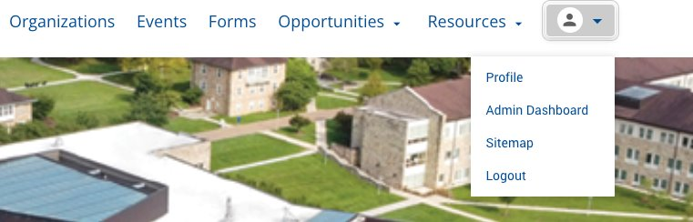
Admin Dashboard

Slide 11
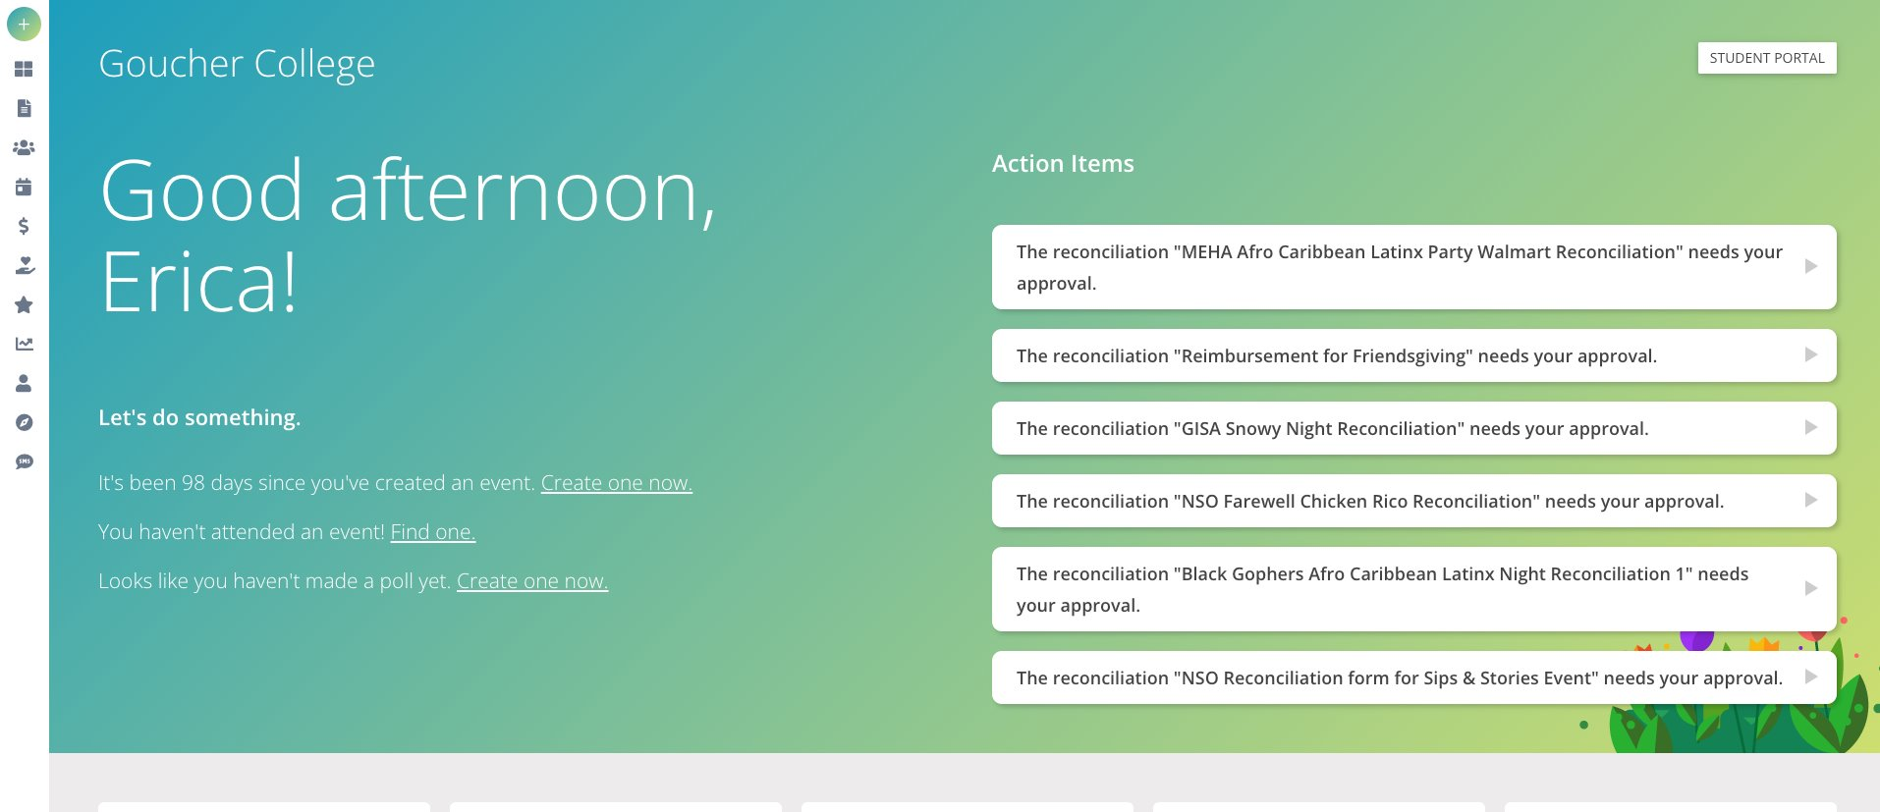

Slide 12
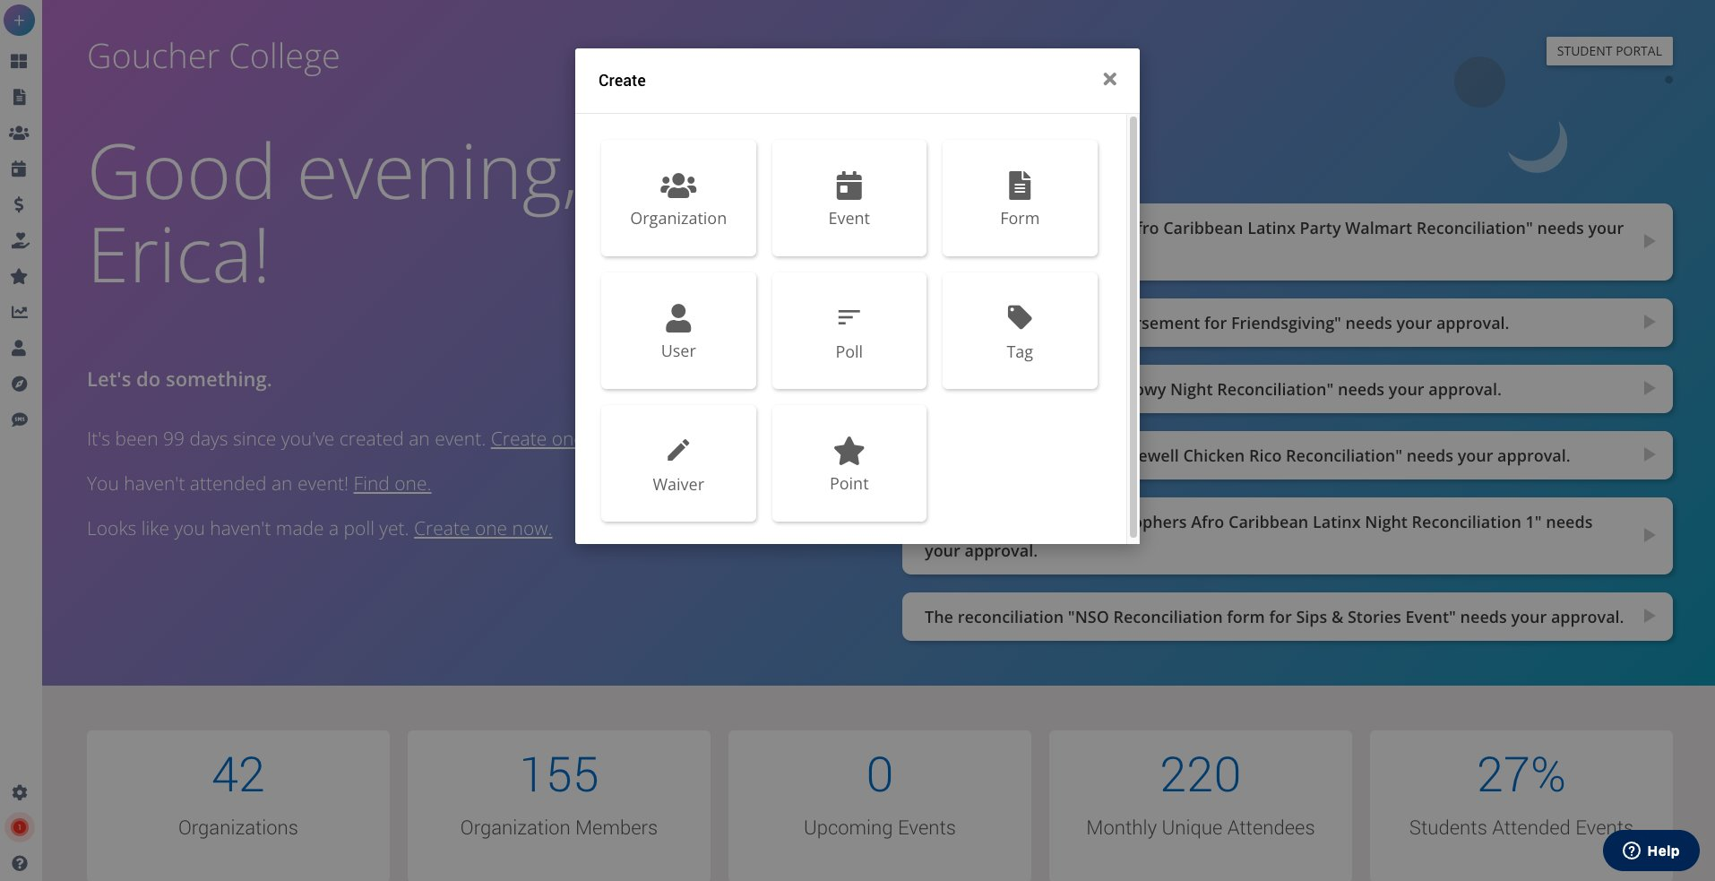
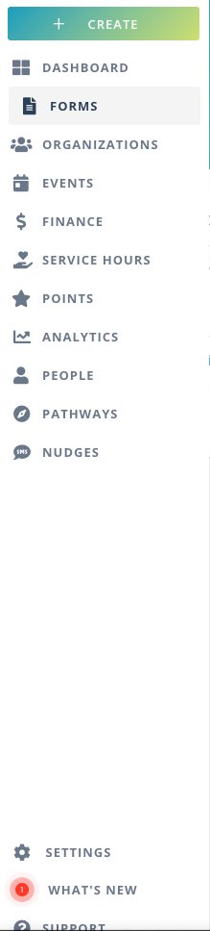

Slide 13
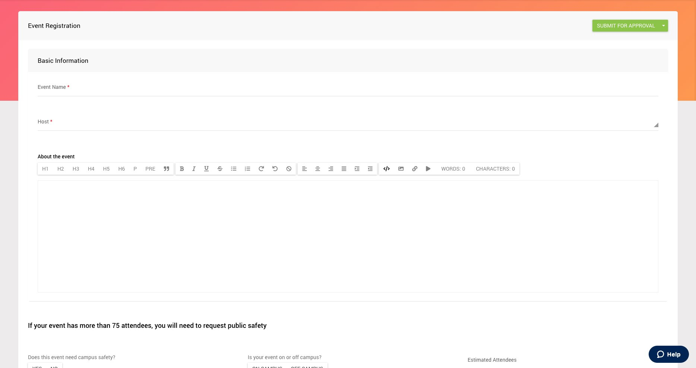

Slide 14
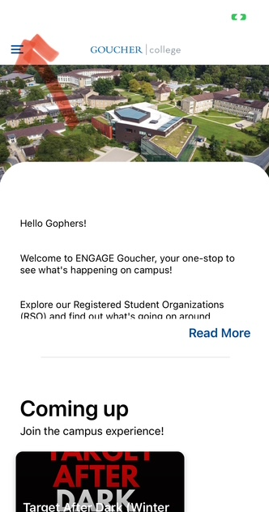
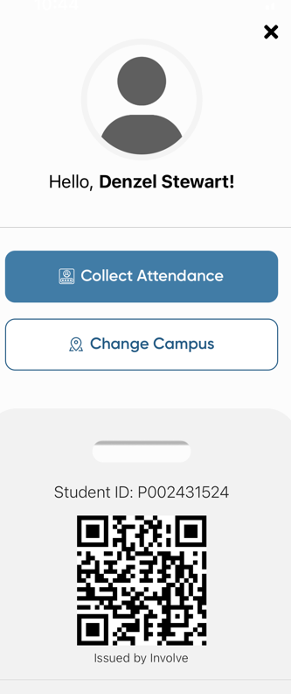
ATTENDANCE TRACKING

Slide 15
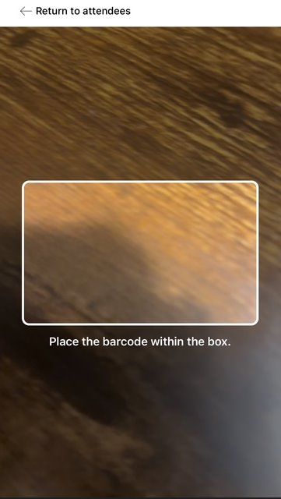
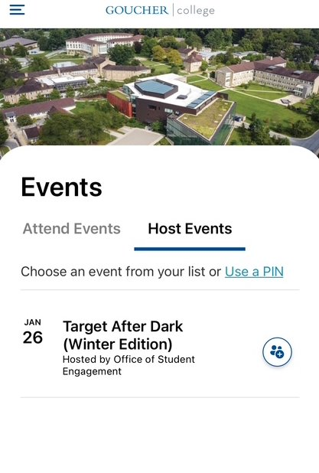
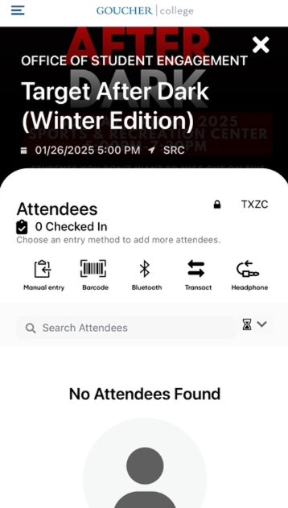
ATTENDANCE TRACKING

Slide 16
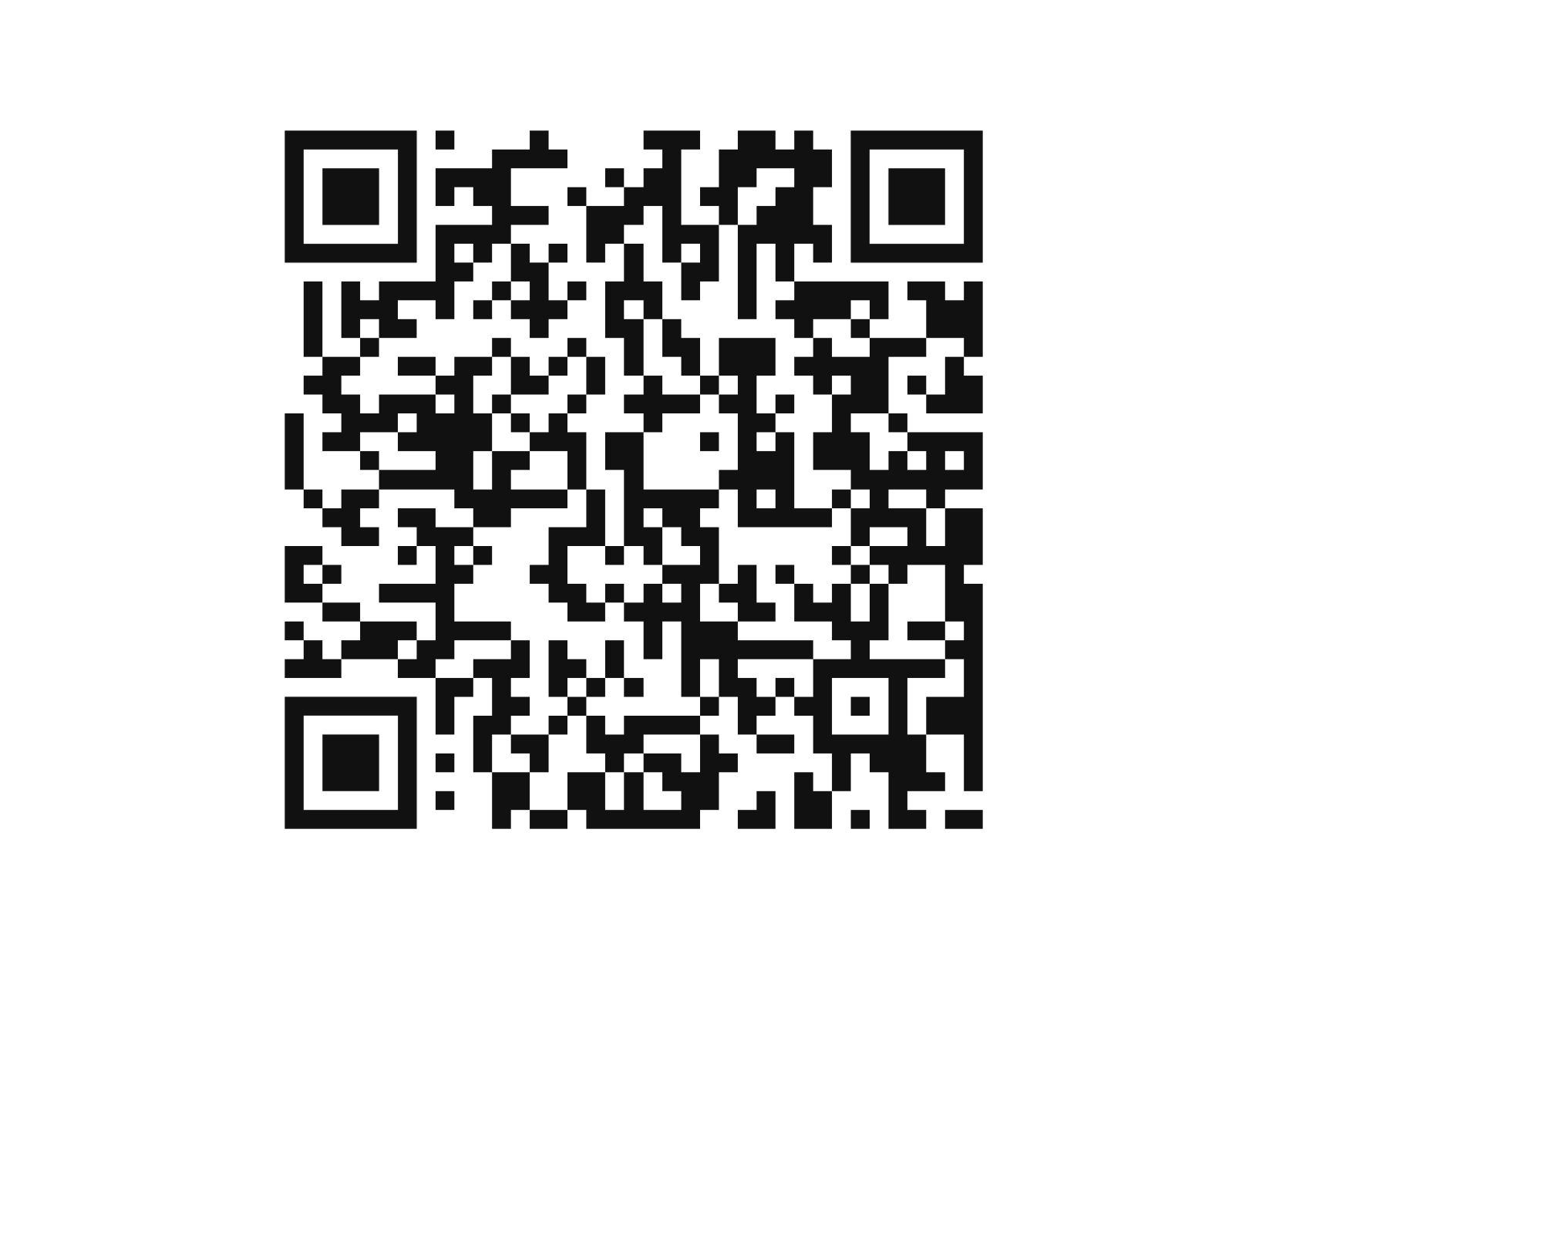
Need support?
https://involve-support.moderncampus.com/hc/en-us

Slide 17
Event management

Slide 18
Advertising
Postings include, but are not limited to posters, flyers, table tents, window clings, and promotional materials.
All Registered Student Organization (RSO) postings must be stamped and approved by OSE prior to copying and posting (RSO Handbook).
Posters/ other forms of advertisement can be approved by any time by SGA Executive Board/Cabinet, OSE Interns, or Pro Staff within the OSE, in person.
However, if your event has not been approved, approved postings should not be put up.

Slide 19
Event deadlines
Distinction between events and club meetings
  Events are open to the wider campus community, generally advertised.
  Club meetings are closed to the wider campus community and only involve club members. Outside speakers or guests are okay here, but generally unadvertised (unless some form of informational meeting).
Events:
No setup required (tech, tables, chairs, etc.), space as is- One week
Setup required- Two weeks
Event has to be submitted before you submit your expenditure
Club Meetings:
(Shouldn't need setup)- One week

Slide 20
Deadline Timeline
Within 2 weeks after reimbursement purchase
2 weeks prior
1 week prior
Event Registration (w/ setup)
Event Registration (w/no setup)
Reconciliation Form IF purchase was reimbursement
Expenditure Request
Club Meeting Registration

Slide 21
Finance & budget

Slide 22



Budget Vocabulary
AKA Budget Request
RSO requesting that a certain amount of money should be set aside for them for the entire academic year
Allocation
AKA Payment Request
RSO requesting to purchase items for an event
Expenditure
Reconciliation
After a purchase has been made, turn in the receipts so the correct amount can be subtracted from an RSO’s allocation

Slide 23
Allocation
An allocation request is a request for funding for the academic year
  i.e. allocation requests made in Fall ‘25 will count for Fall ‘25 and Spring ‘26
The allocation request must be approved by the SGA Senate
  SGA Senate meeting time is TBD
Allocation requests are an outline of the budget for your RSO for the year
Allocation requests must be submitted via the form in ENGAGE: Goucher
An allocation request being approved by the Senate DOES NOT mean that an RSO can start spending the money they requested whenever they want
The allocation request being approved by the Senate simply means that SGA is agreeing to set aside the amount requested by the RSO for the academic year for the RSO
It does not mean that SGA is giving the RSO a blank check

Slide 24
BIG CHANGES

Slide 25
New Allocation system
The new system for allocations will be a tiered system rather than a set budget
There will be 3 tiers in this system
  Tier 1(lowest tier): will have a maximum allocation budget of $500
  Tier 2(middle tier): will have a maximum allocation budget of $1,000
  Tier 3(highest tier): will have a maximum allocation budget of $1,500
NEW RSOS ARE NOT ELIGIBLE FOR TIER 3
When submitting your allocation budget, the request should be broken down into categories i.e. events, food, travel, decorations, etc.
  The more in-depth you are with your request increases your chances of being in a higher tier
Ways and Means committee will select a recommended tier
The Senate will decide what tier your club will be placed in
  If you would like to advocate for your club to be in a higher tier reach out and ATTEND A General Assembly Meeting!!
You are required to have your Club Interest Meeting before you can submit your allocation
  Evidence will be required in Engage form
The number of members in your club will need to be stated in form when submitting allocation

Slide 26
Allocation appeal
The new system will include an appeal process where your club can request additional money on top of the money already allocated
  The maximum a club can appeal for is $1,000
  A MAXIMUM OF FIVE RSOS CAN BE APPROVED FOR AN APPEAL(subject to change)
You can appeal once your allocation budget has been approved
Allocation appeal requests must be submitted via the form in ENGAGE: Goucher
The appeal must be approved by the Ways and Means committee before it reaches the Senate
  Ways and Means has the power to approve, amend or deny the appeal
  If denied your appeal WILL NOT go to the Senate
  If amended the appeal will be sent back with notes, and must be resubmitted
Once approved the appeal goes to the Senate
  It is REQUIRED that at least ONE club officer and TWO non-SGA club members attend the GA to advocate for their appeal
  The Senate will then decide whether to approve, amend, or deny

Slide 27
Expenditure
An expenditure request is a request to spend the money allocated for an RSO via a previous allocation request
Expenditure requests must be approved by:
  The SGA Senate and the Ways and Means Committee if the amount is greater than $250
  The SGA Treasurer if the amount is less than $250
SGA requires 2 weeks notice for expenditure requests
  i.e. RSOs should be submitting expenditure requests 2 weeks or more before the date that they need the items by
  4 weeks for hiring outside contracts
  If your expenditure request does not meet this timeline it will be AUTOMATICALLY DENIED
Expenditure requests must be submitted via the form in ENGAGE: Goucher
An estimation of attendees for events will be required in form
  You must list a realistic number of attendees
Examples of purchases that need expenditure requests:
  Amazon purchases
  Pick-up orders
    E.g. Safeway, Walmart, etc.
  Reimbursements
  Hiring outside groups
  Ordering catering
  ANY PURCHASE THAT AN RSO WANTS TO MAKE
Estimating the amount for an expenditure request is OK
  SGA would rather an RSO ask for more, and need less, than ask for less, and need more

Slide 28
Reimbursements
Must be approved before RSO members make purchases
Reimbursement

Slide 29
Reconciliation
After a purchase is made for an RSO, the receipt for that purchase must be put into the Reconciliation form in ENGAGE: Goucher
Most of the time, it will be SGA who puts the receipt in on behalf of the RSO, as SGA will be making most of the purchases via credit card
For reimbursements, the RSO will need to submit the reconciliation form with their receipt
The purpose of this step in the financial process is to ensure accuracy in the bookkeeping
  After the reconciliation form is completed, the actual amount of the purchase will be taken from an RSOs allocation, not the amount requested
  E.g. if an RSO requests $200 for food, but ends up spending only $194.65, once the reconciliation form is filled out with the accurate amount, $194.65 will be removed from the allocation, not $200

Slide 30

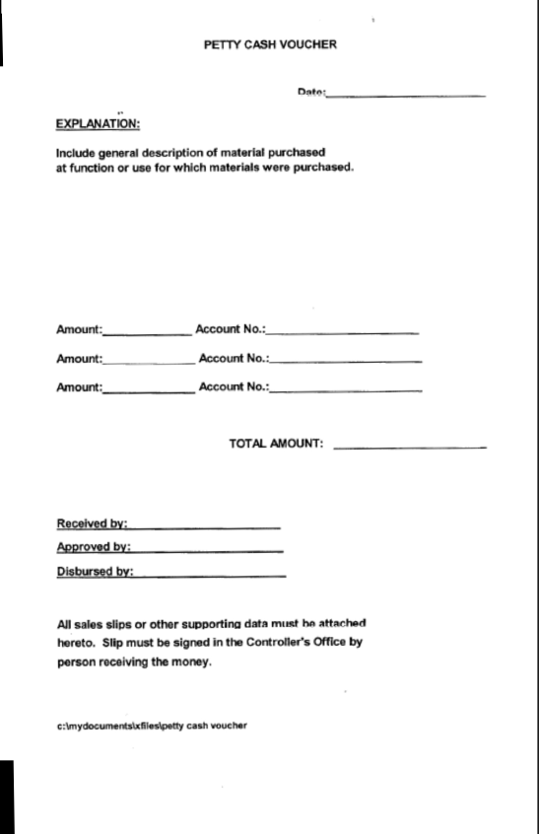
Reimbursement Form
YOU fill out highlighted fields
SGA fills out the rest
Can be found in OSE office on the windowsill
Turn form into SGA Treasurer

Slide 31
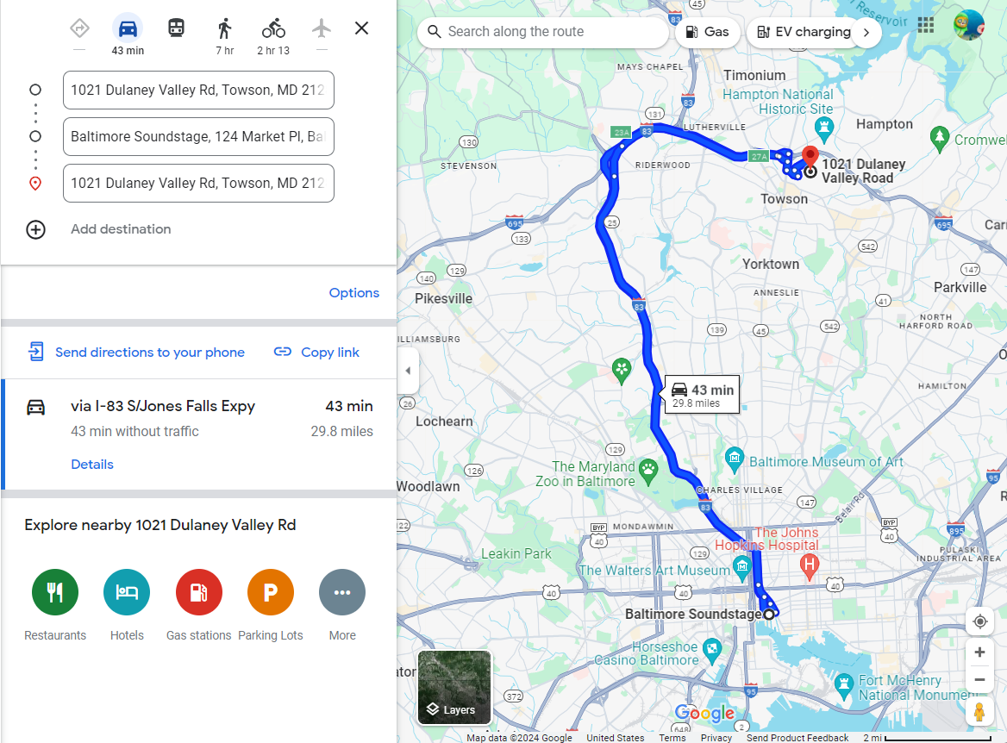
Gas Reimbursements
The receipt for gas mileage reimbursements is a printout of the route taken on Google Maps or another similar platform
Components that need to be visible on the screenshot:
  Starting address
  Ending address
  Total mileage of route
The Controller’s office reimburses for gas using the IRS standard rate ($0.70/mile)
Reimbursement will be via check, not cash, regardless of amount

Slide 32
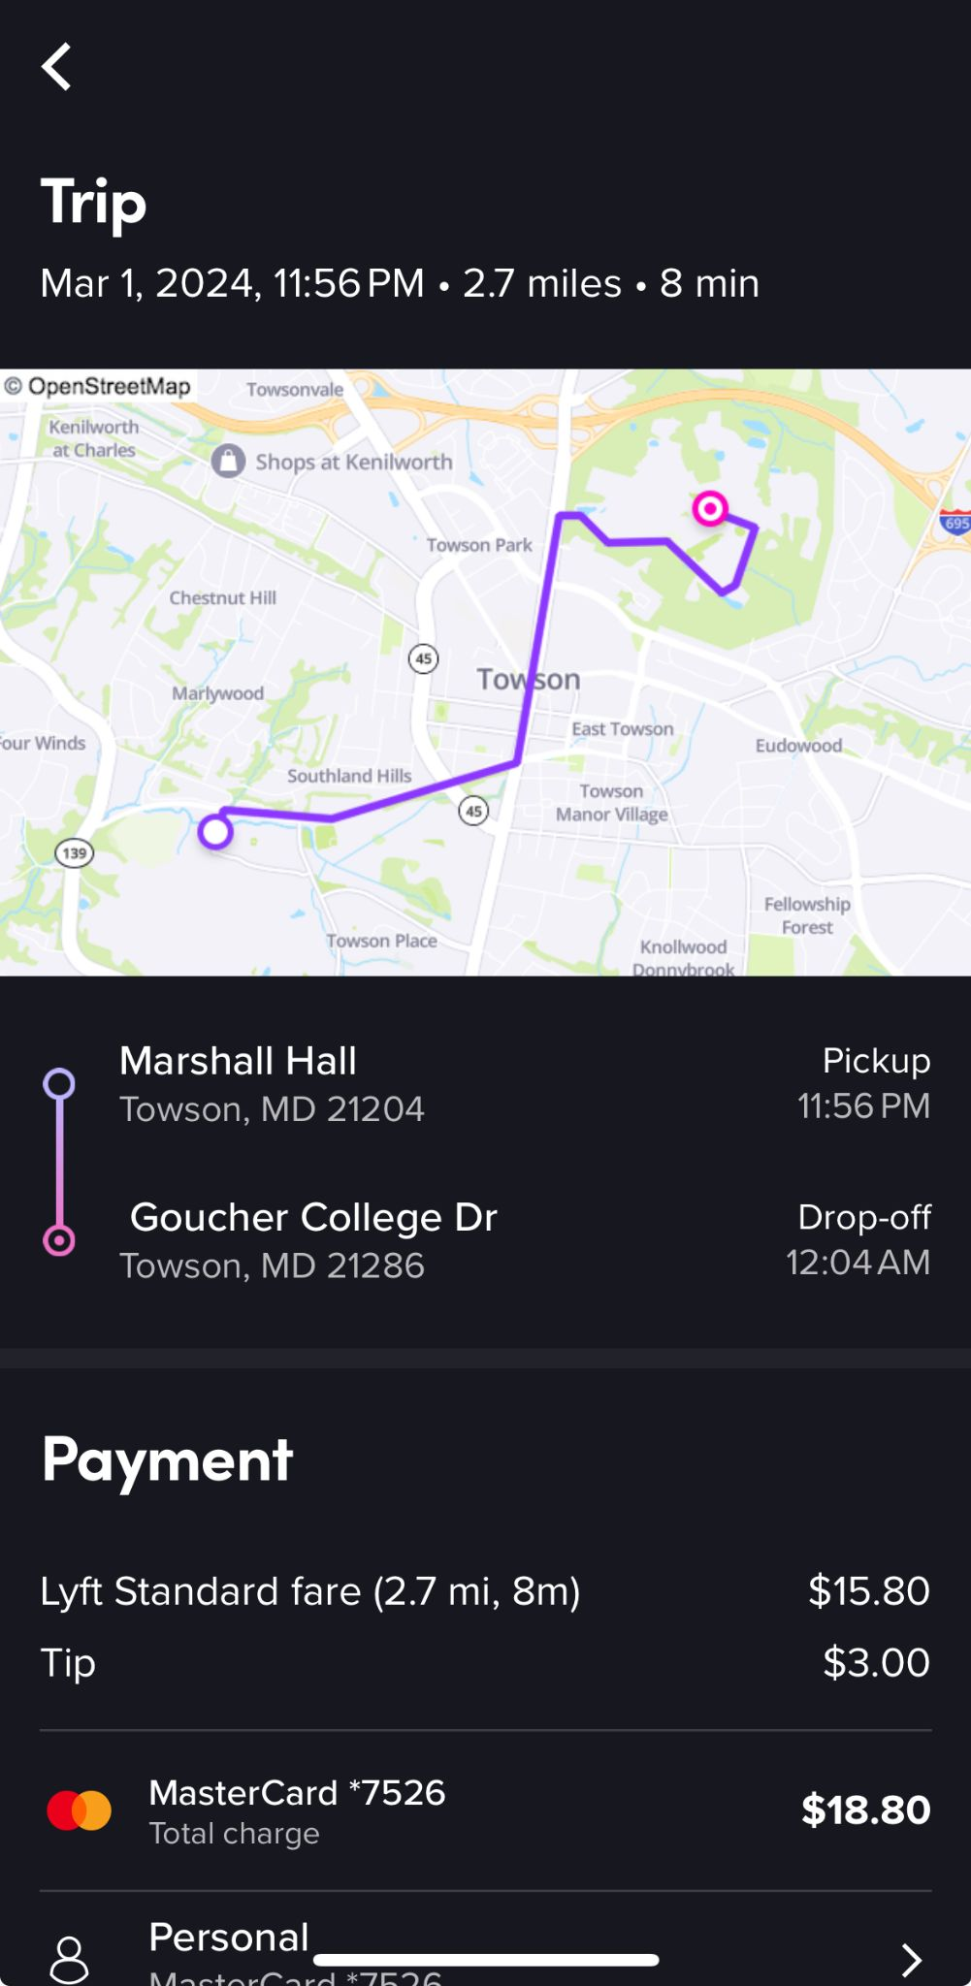
Uber/lyft Reimbursements
For a receipt for Uber/Lyft reimbursements, you need a screenshot of the receipt with the following visible:
  Ride date/time
  Starting address
  Ending address
  Total mileage
  Payment line at the bottom

Slide 33
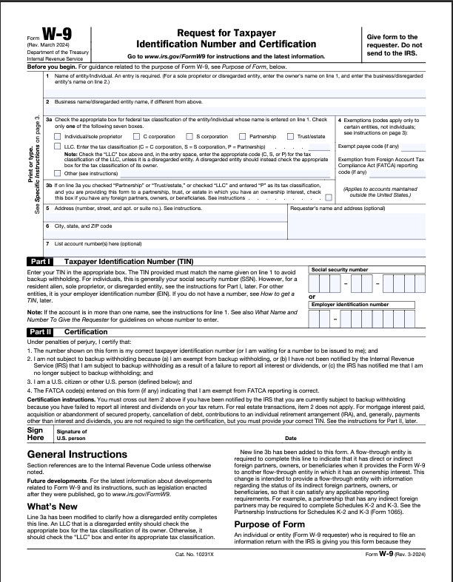
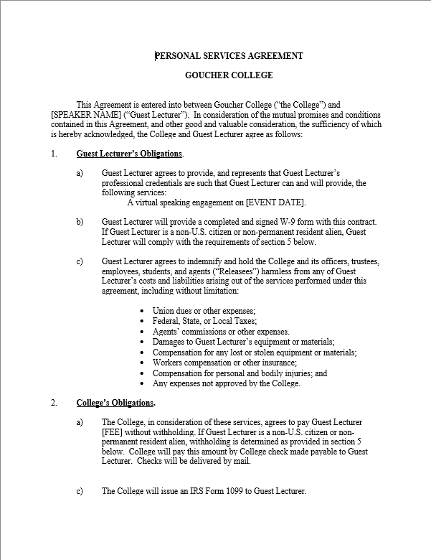
Hiring an outside contract
You need:
W9 (all fields must be complete)
Contract
  Group’s contract if they have one
  If not, Goucher has a Personal Services Agreement Contract
    Must be submitted as a Word document
    Must include vendor's signature
Invoice
  Address must match that on the W-9
Expenditure requests for hiring an outside contract must be submitted 4 weeks in advance to allow for processing of forms

